Slide 1

User Interface
Wenxuan Shi
College of Software, Nankai University
Email: shiwx@nankai.edu.cn
Wechat: 13920561100

Slide 2
Topics
Introduction to widgets
Building layouts
Splash screens
Adding interactivity
Assets and images
Notes:
Brand-driven == customized
Internal teams at Google (CRM system) have managed to build functioning prototypes in a week.
Designers with 0 coding experiences became productive with Flutter in weeks - allowing them to build prototypes in hours.

Slide 3
Introduction to widgets
Notes:
StatelessWidget is used for immutable elements that only rely on the object configuration information
StatefulWidget is used for elements that can dynamically change based on state-changes in the system
Everytime that state changes, setChange() is called by the object

Slide 4
Introduction
Flutter widgets are built using a modern framework that takes inspiration from React.
The central idea is that you build your UI out of widgets.
Widgets describe what their view should look like given their current configuration and state.
Note: If you would like to become better acquainted with Flutter by diving into some code, check out the basic layout codelab, building layouts, and adding interactivity to your Flutter app.

Slide 5
Contents
Hello world
Basic widgets
Using Material Components
Handling gestures
Changing widgets in response to input
Bringing it all together
Responding to widget lifecycle events
Keys
Global Keys
Notes:
Brand-driven == customized
Internal teams at Google (CRM system) have managed to build functioning prototypes in a week.
Designers with 0 coding experiences became productive with Flutter in weeks - allowing them to build prototypes in hours.

Slide 6
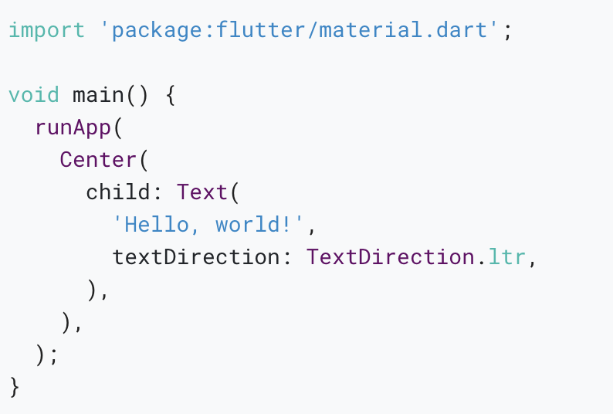
Hello world
The minimal Flutter app simply calls the runApp() function with a widget:
The runApp() function takes the given Widget and makes it the root of the widget tree.
In this example, the widget tree consists of two widgets, the Center widget and its child, the Text widget.

Slide 7
Basic widgets
Text: The Text widget lets you create a run of styled text within your application.
Row, Column: These flex widgets let you create flexible layouts in both the horizontal (Row) and vertical (Column) directions. The design of these objects is based on the web’s flexbox layout model.

Slide 8
Stack: Instead of being linearly oriented (either horizontally or vertically), a Stack widget lets you place widgets on top of each other in paint order. You can then use the Positioned widget on children of a Stack to position them relative to the top, right, bottom, or left edge of the stack.
Container: The Container widget lets you create a rectangular visual element. A container can be decorated with a BoxDecoration, such as a background, a border, or a shadow.
Notes:
The beauty of hot reload is, that even after fixing an error, state is still maintained - allowing to iterate and develop far quicker.

Slide 9
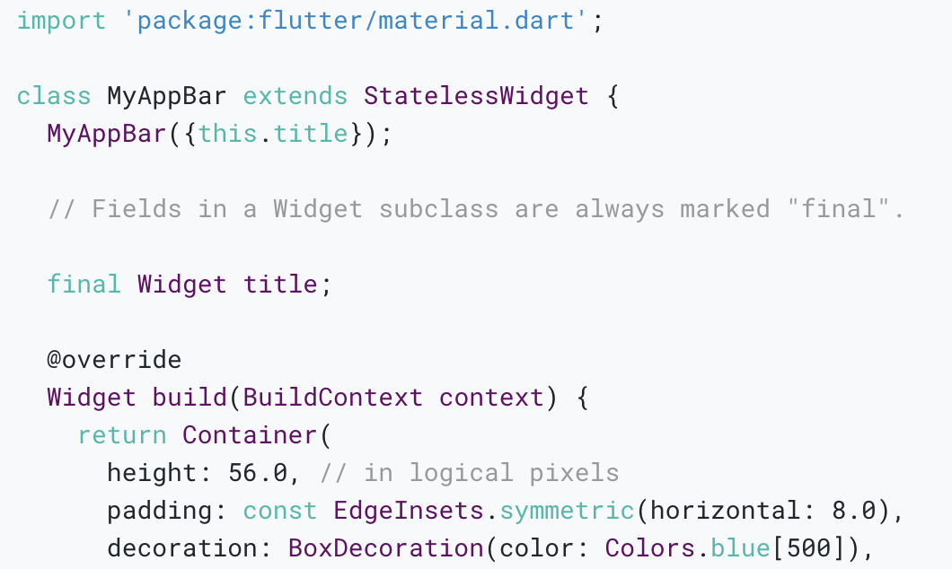
Notes:
The beauty of hot reload is, that even after fixing an error, state is still maintained - allowing to iterate and develop far quicker.

Slide 10
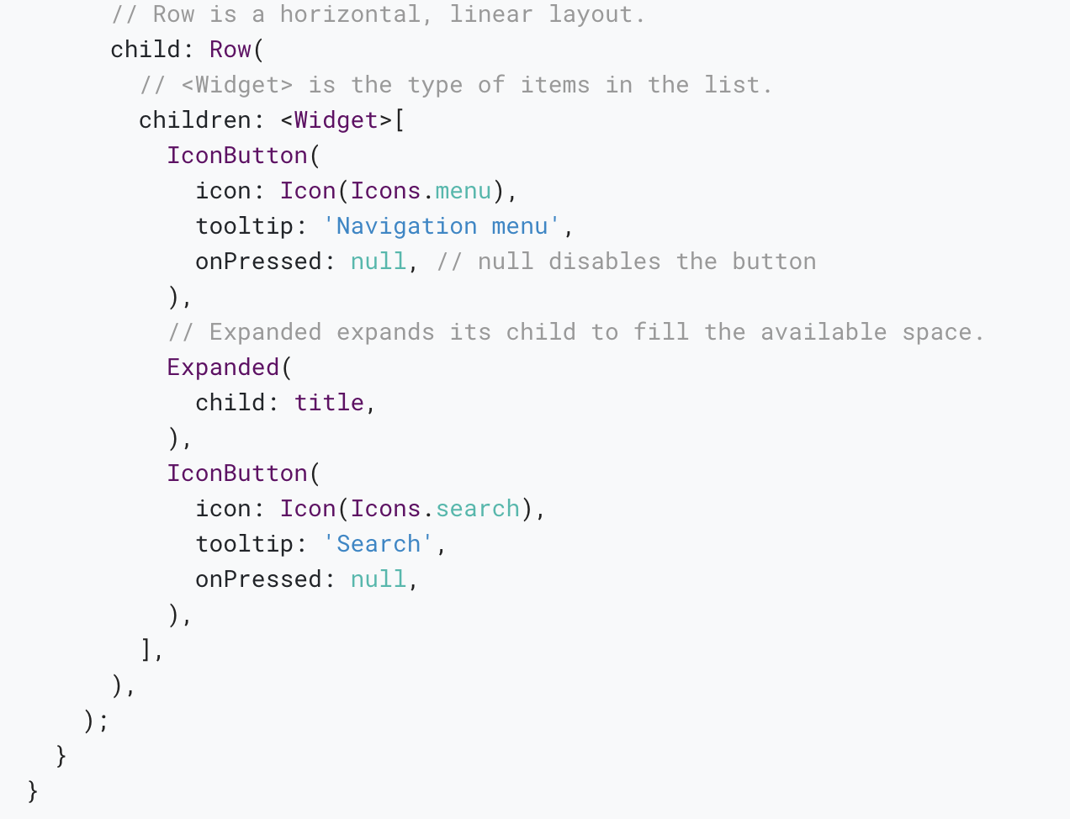
Notes:
Also available via IntelliJ’s built-in debugger

Slide 11
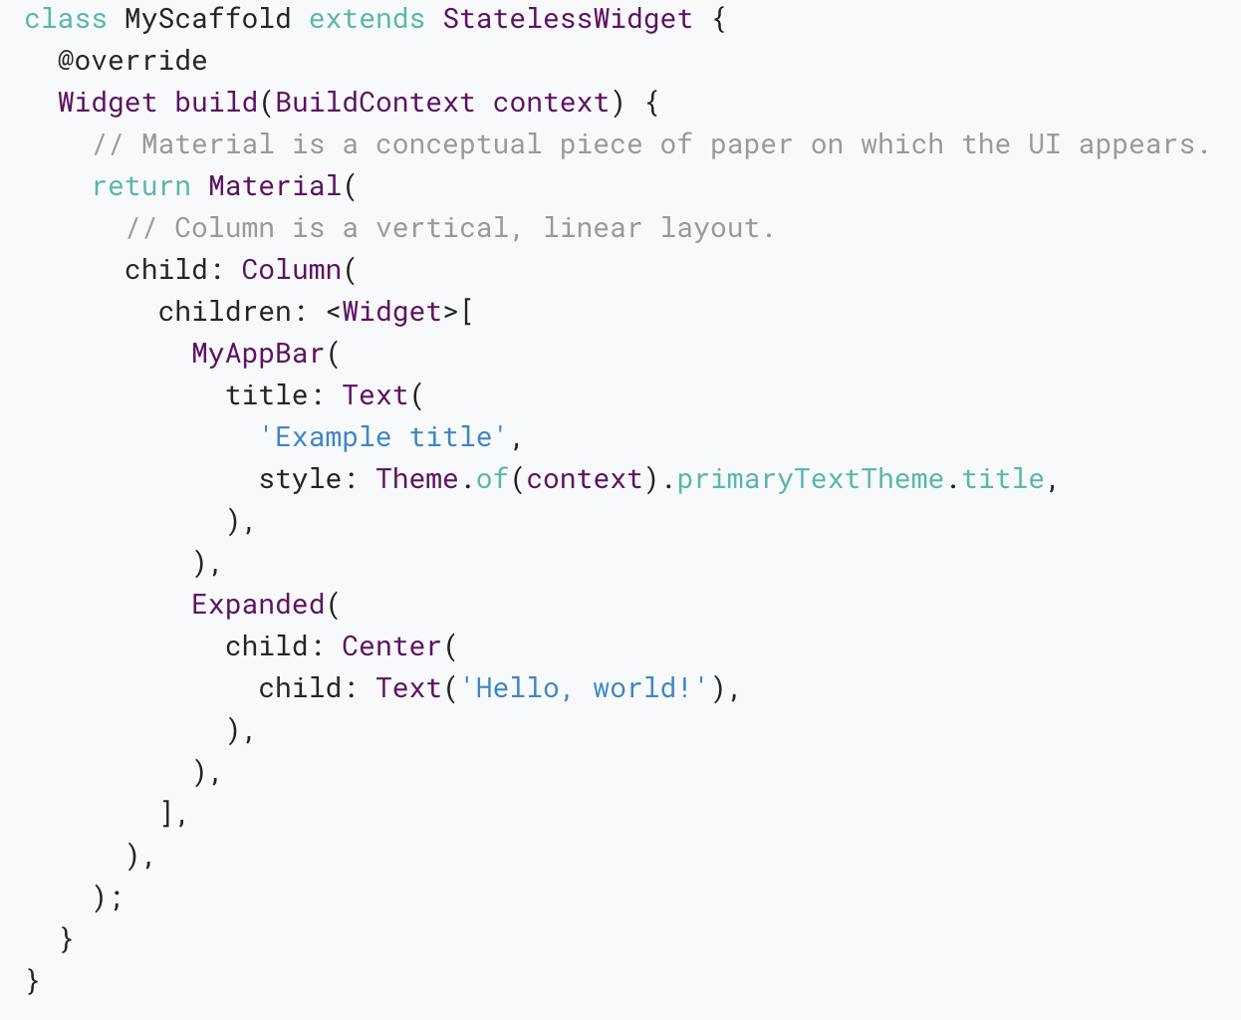
Notes:
Also available via IntelliJ’s built-in debugger

Slide 12
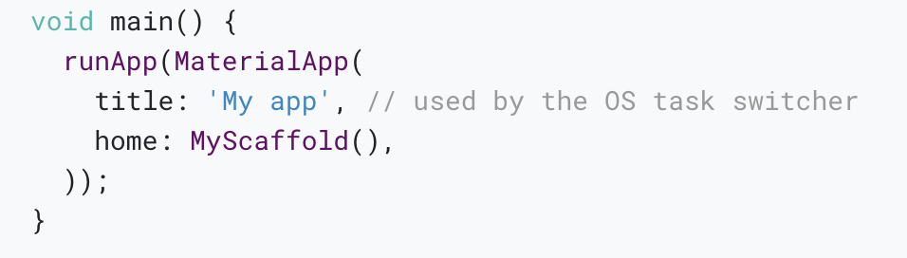
Notes:
Also available via IntelliJ’s built-in debugger

Slide 13
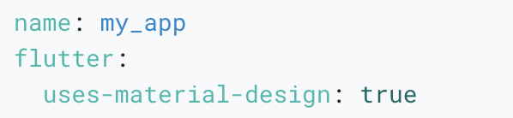
Be sure to have a uses-material-design: true entry in the flutter section of your pubspec.yaml file. It allows you to use the predefined set of Material icons.

Slide 14
Using Material Components
Flutter provides a number of widgets that help you build apps that follow Material Design.
A Material app starts with the MaterialApp widget, which builds a number of useful widgets at the root of your app, including a Navigator, which manages a stack of widgets identified by strings, also known as “routes”.

Slide 15
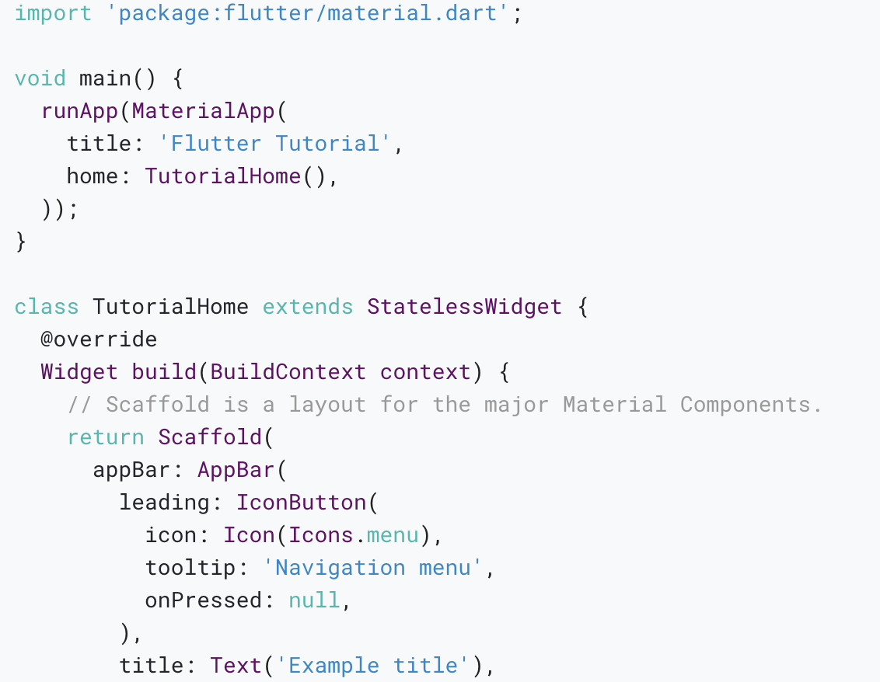

Slide 16
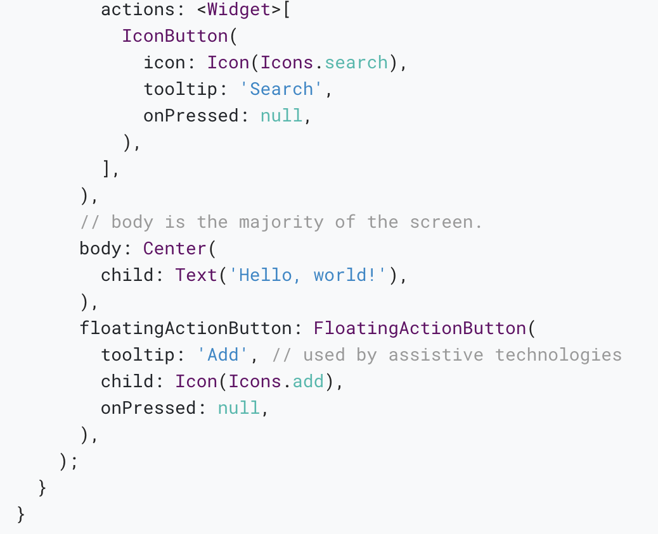

Slide 17
Handling gestures
Most applications include some form of user interaction with the system. The first step in building an interactive application is to detect input gestures. See how that works by creating a simple button:

Slide 18
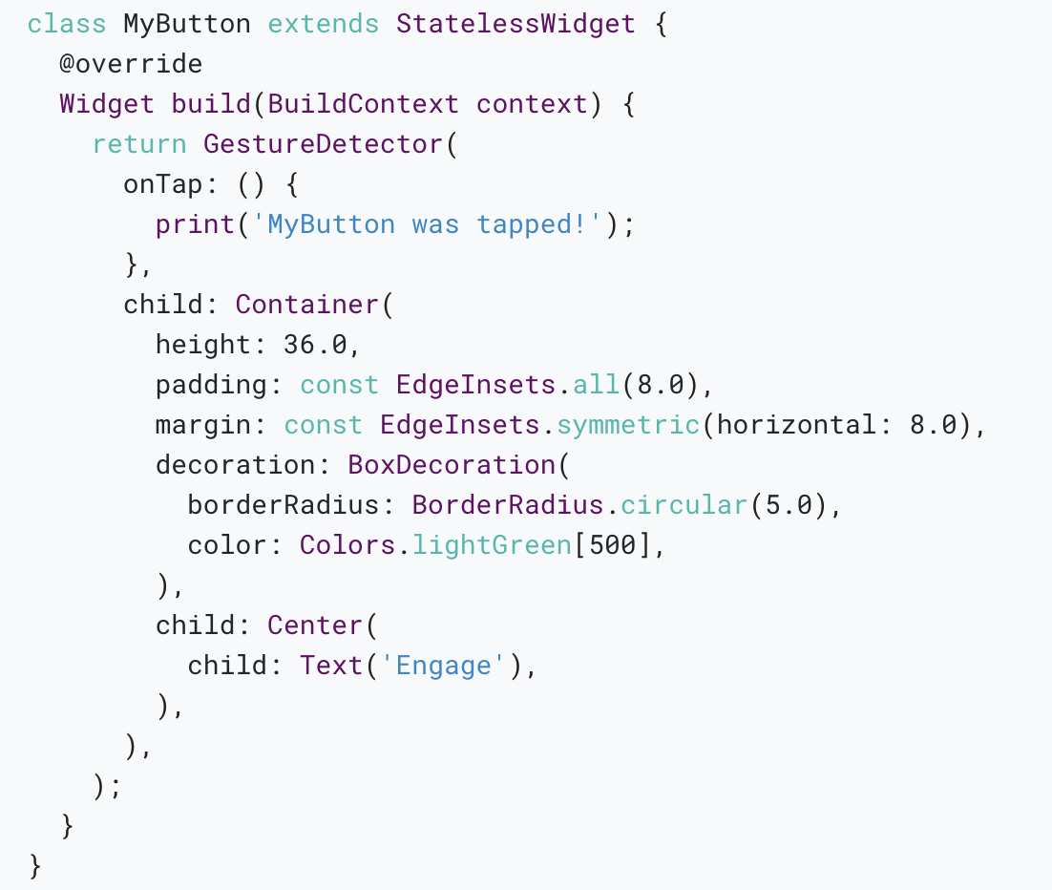

Slide 19
Changing widgets in response to input
In order to build more complex experiences—for example, to react in more interesting ways to user input—applications typically carry some state.
Flutter uses StatefulWidgets to capture this idea.
StatefulWidgets are special widgets that know how to generate State objects, which are then used to hold state.

Slide 20
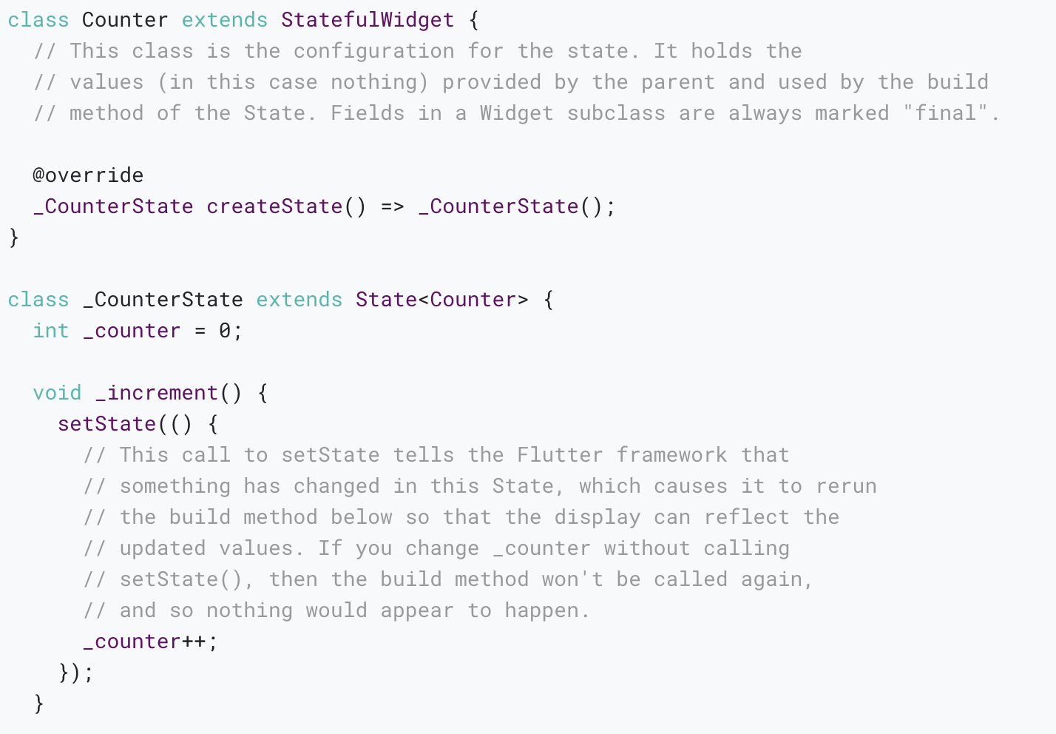

Slide 21
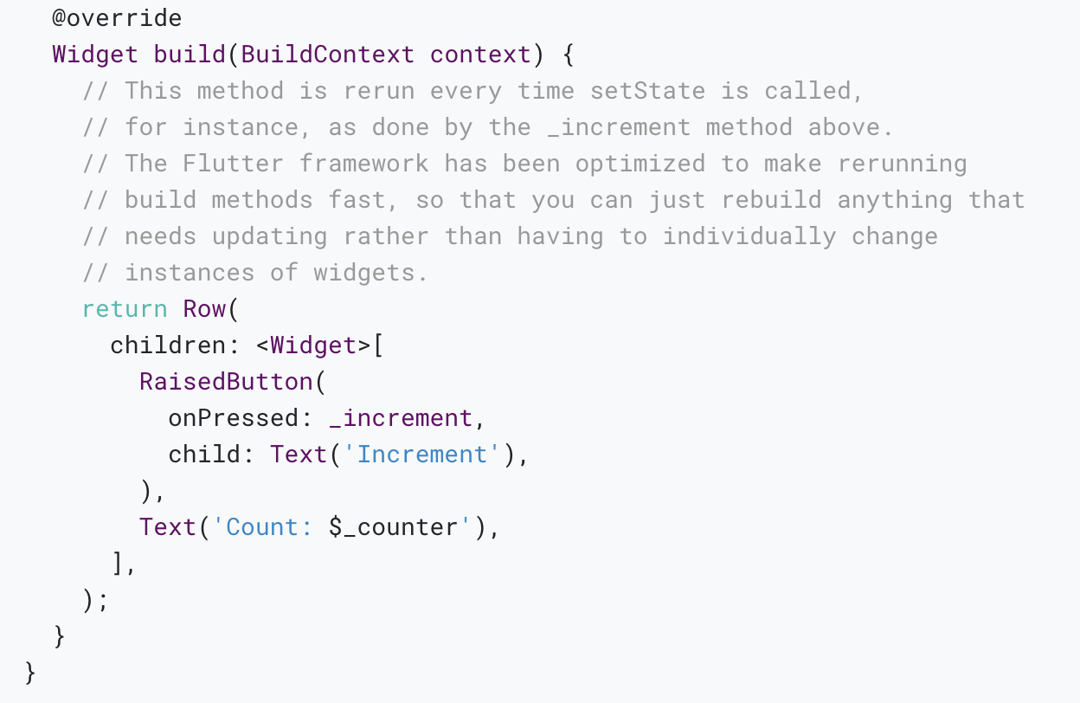

Slide 22
Bringing it all together
What follows is a more complete example that brings together these concepts: A hypothetical shopping application displays various products offered for sale, and maintains a shopping cart for intended purchases.
Start by defining the presentation class, ShoppingListItem:

Slide 23
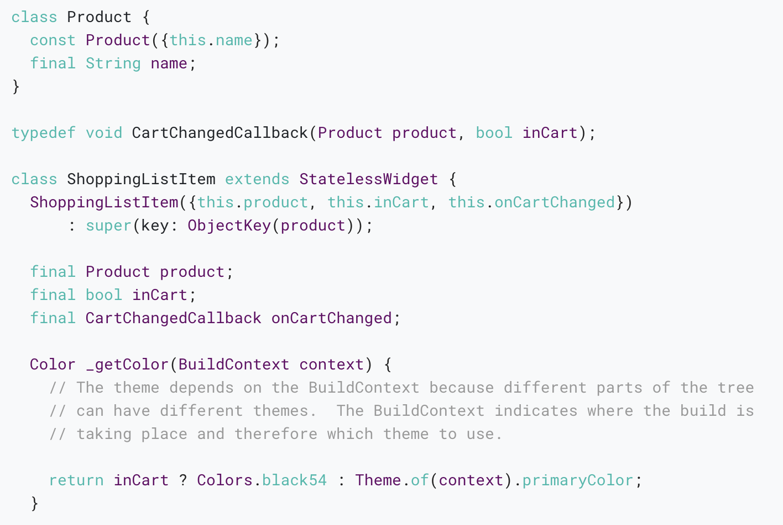

Slide 24
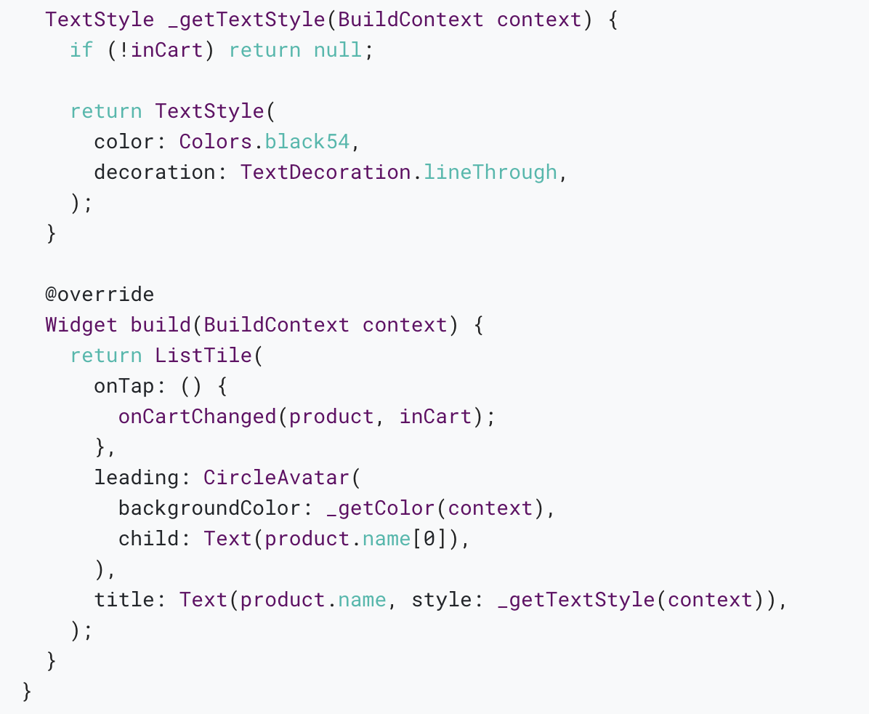

Slide 25
Responding to widget lifecycle events
After calling createState() on the StatefulWidget, the framework inserts the new state object into the tree and then calls initState() on the state object.
A subclass of State can override initState to do work that needs to happen just once.
For example, override initState to configure animations or to subscribe to platform services.

Slide 26
Keys
Keys are most useful in widgets that build many instances of the same type of widget.
For example, the ShoppingList widget, which builds just enough ShoppingListItem instances to fill its visible region:
Without keys, the first entry in the current build would always sync with the first entry in the previous build, even if, semantically, the first entry in the list just scrolled off screen and is no longer visible in the viewport.
By assigning each entry in the list a “semantic” key, the infinite list can be more efficient because the framework syncs entries with matching semantic keys and therefore similar (or identical) visual appearances.

Slide 27
Global Keys
Use global keys to uniquely identify child widgets.
Global keys must be globally unique across the entire widget hierarchy, unlike local keys which need only be unique among siblings.
Because they are globally unique, a global key can be used to retrieve the state associated with a widget.

Slide 28
Building Layouts
Notes:
StatelessWidget is used for immutable elements that only rely on the object configuration information
StatefulWidget is used for elements that can dynamically change based on state-changes in the system
Everytime that state changes, setChange() is called by the object

Slide 29
What's the point?
Widgets are classes used to build UIs.
Widgets are used for both layout and UI elements.
Compose simple widgets to build complex widgets.
Here’s a diagram of the widget tree for this UI:

Slide 30
Lay out a widget
How do you layout a single widget in Flutter? This section shows you how to create and display a simple widget. It also shows the entire code for a simple Hello World app.
In Flutter, it takes only a few steps to put text, an icon, or an image on the screen.

Slide 31
1. Select a layout widget
Choose from a variety of layout widgets based on how you want to align or constrain the visible widget, as these characteristics are typically passed on to the contained widget.
This example uses Center which centers its content horizontally and vertically.

Slide 32
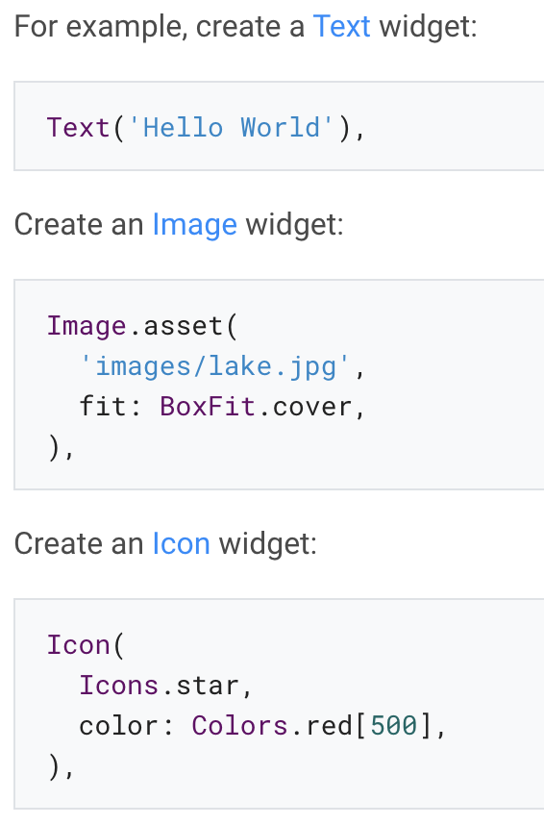
2. Create a visible widget

Slide 33
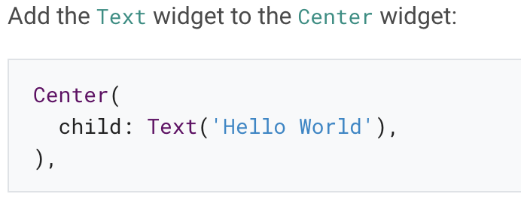
3. Add the visible widget to the layout widget
All layout widgets have either of the following:
A child property if they take a single child – for example, Center or Container
A children property if they take a list of widgets – for example, Row, Column, ListView, or Stack.

Slide 34
4. Add the layout widget to the page
A Flutter app is itself a widget, and most widgets have a build() method. Instantiating and returning a widget in the app’s build() method displays the widget.

Slide 35
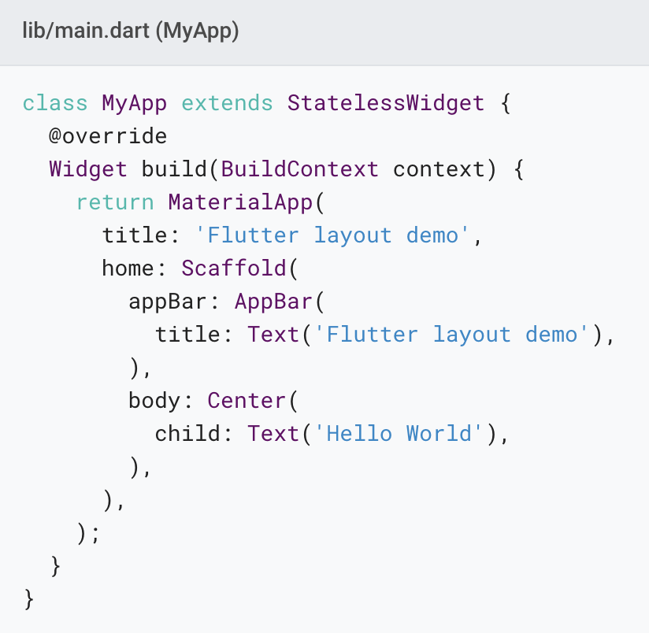
Material apps
For a Material app, you can use a Scaffold widget; it provides a default banner, background color, and has API for adding drawers, snack bars, and bottom sheets. Then you can add the Center widget directly to the body property for the home page.

Slide 36
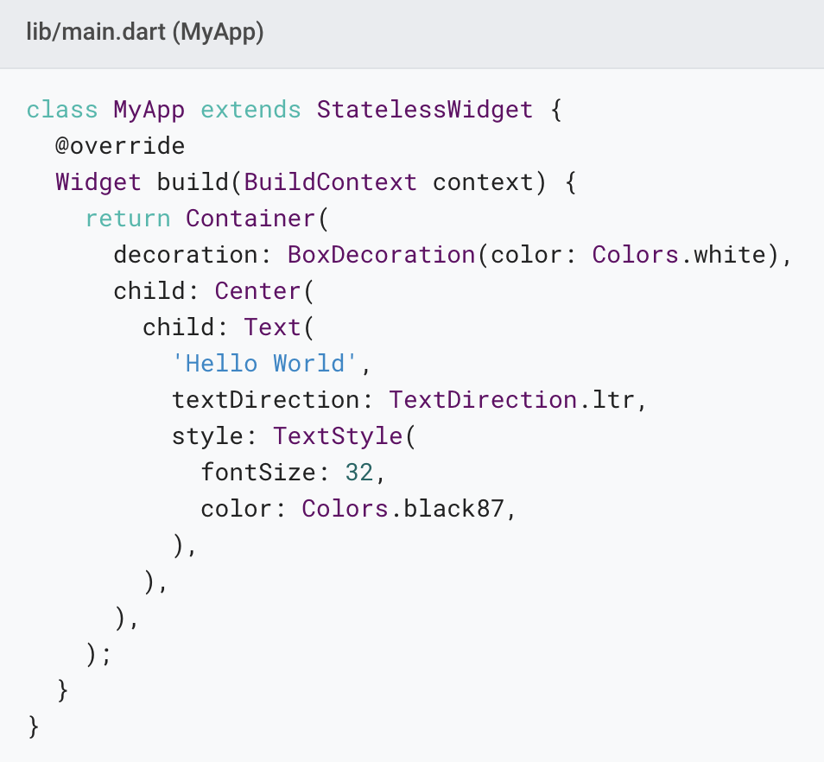
Non-Material apps
For a non-Material app, you can add the Center widget to the app’s build() method:

Slide 37
App source code:
Material app
Non-Material app

Slide 38
Lay out multiple widgets vertically and horizontally
What's the point?
Row and Column are two of the most commonly used layout patterns.
Row and Column each take a list of child widgets.
A child widget can itself be a Row, Column, or other complex widget.
You can specify how a Row or Column aligns its children, both vertically and horizontally.
You can stretch or constrain specific child widgets.
You can specify how child widgets use the Row’s or Column’s available space.

Slide 39
This layout is organized as a Row.

Slide 40
The left column’s widget tree nests rows and columns.

Slide 41
Aligning widgets
You control how a row or column aligns its children using the mainAxisAlignment and crossAxisAlignment properties.

Slide 42
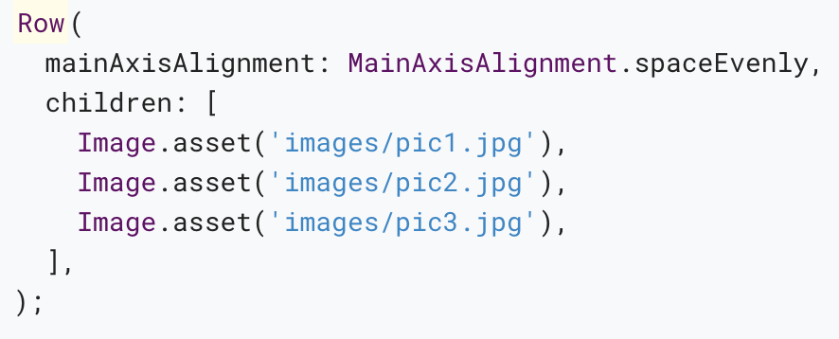
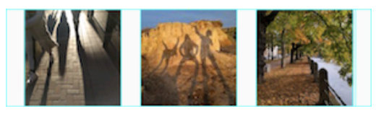
In the following example, each of the 3 images is 100 pixels wide.
App source: row_column

Slide 43
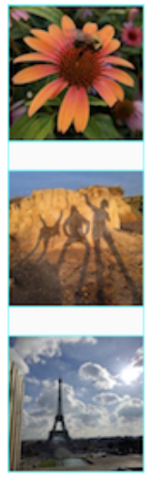
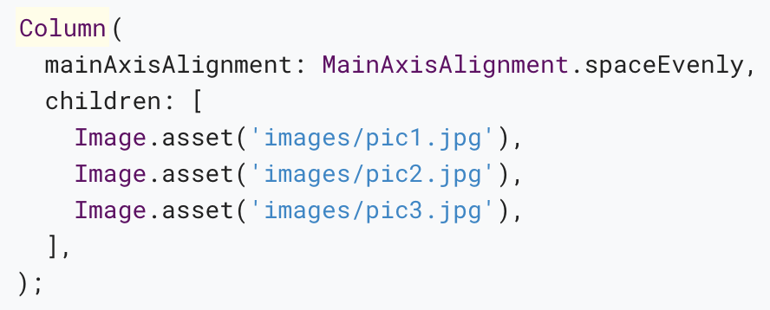
The following example shows a column of 3 images, each is 100 pixels high.

Slide 44
Sizing widgets
When a layout is too large to fit a device, a yellow and black striped pattern appears along the affected edge.
Here is an example of a row that is too wide:

Slide 45
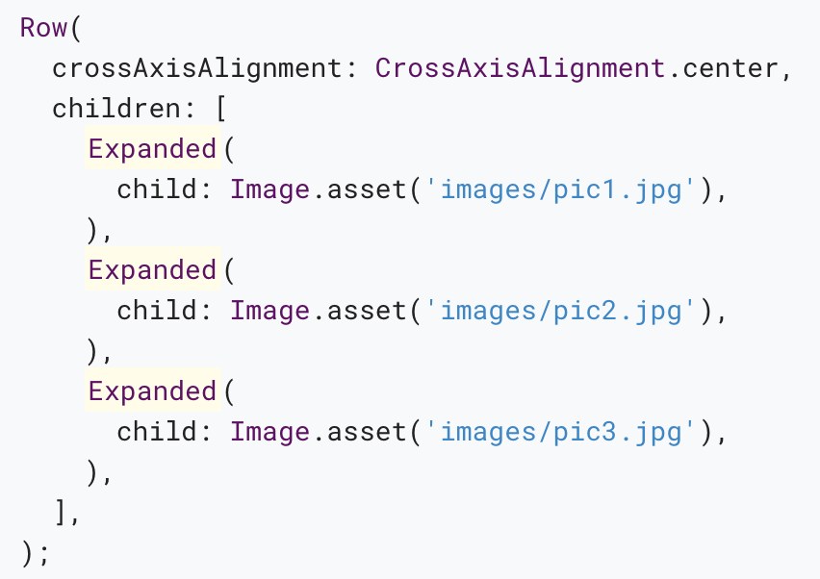
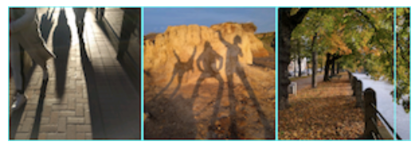
Widgets can be sized to fit within a row or column by using the Expanded widget.
App source: sizing

Slide 46
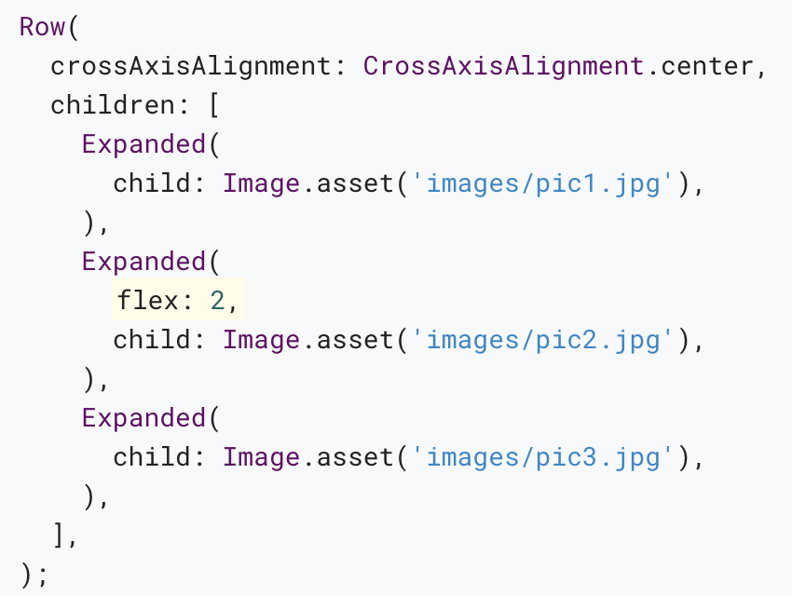
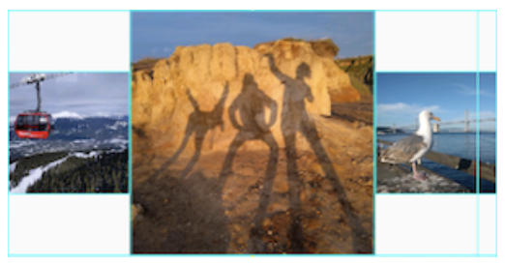
Perhaps you want a widget to occupy twice as much space as its siblings.
App source: sizing

Slide 47
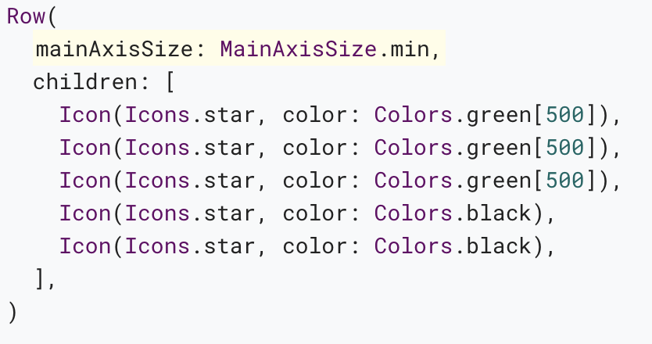
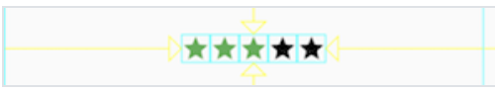
Packing widgets
By default, a row or column occupies as much space along its main axis as possible, but if you want to pack the children closely together, set its mainAxisSize to MainAxisSize.min.
App source: pavlova

Slide 48
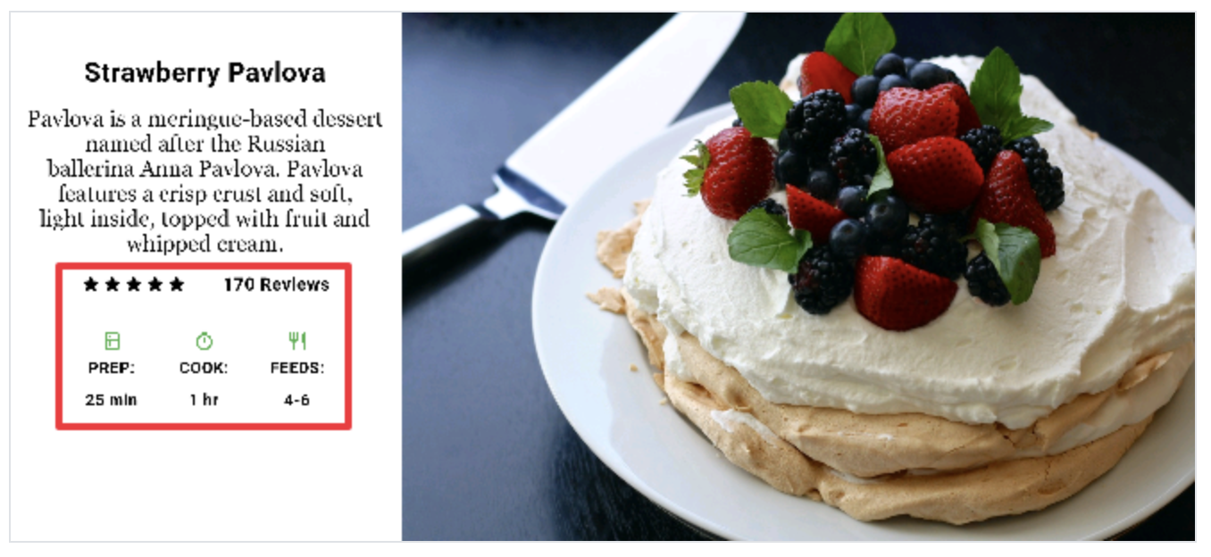
Nesting rows and columns
The layout framework allows you to nest rows and columns inside of rows and columns as deeply as you need.
App source: pavlova

Slide 49
Common layout widgets
Flutter has a rich library of layout widgets.
The following widgets fall into two categories: standard widgets from the widgets library, and specialized widgets from the Material library.

Slide 50
Standard widgets
Container: Adds padding, margins, borders, background color, or other decorations to a widget.
GridView: Lays widgets out as a scrollable grid.
ListView: Lays widgets out as a scrollable list.
Stack: Overlaps a widget on top of another.

Slide 51
Material widgets
Card: Organizes related info into a box with rounded corners and a drop shadow.
ListTile: Organizes up to 3 lines of text, and optional leading and trailing icons, into a row.

Slide 52
Container
Add padding, margins, borders
Change background color or image
Contains a single child widget, but that child can be a Row, Column, or even the root of a widget tree

Slide 53
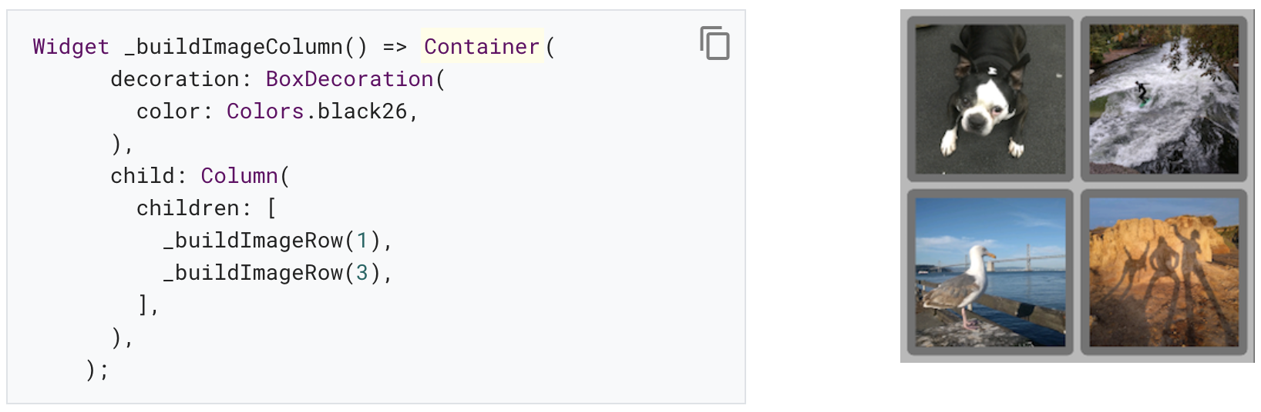
Examples (Container)
App source: container

Slide 54
GridView
Lays widgets out in a grid
Detects when the column content exceeds the render box and automatically provides scrolling
Build your own custom grid, or use one of the provided grids:
GridView.count allows you to specify the number of columns
GridView.extent allows you to specify the maximum pixel width of a tile

Slide 55
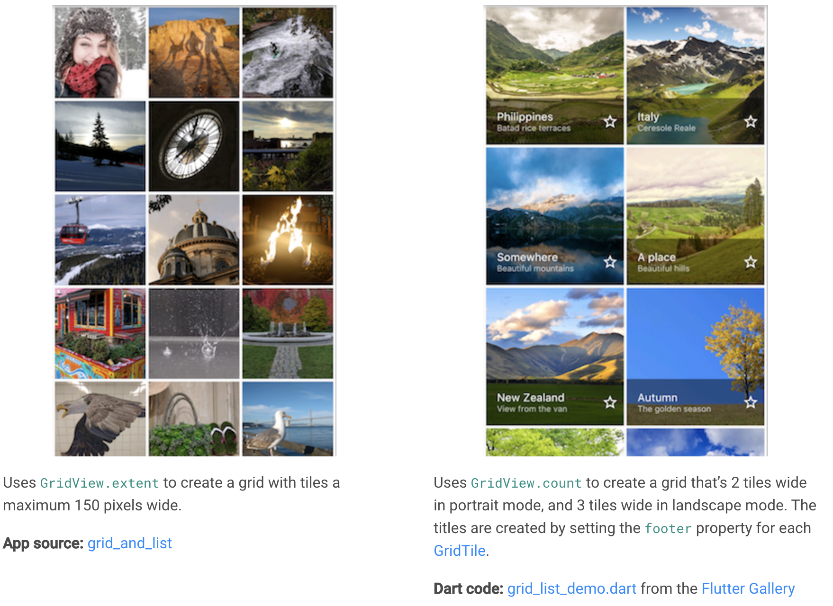
Examples (GridView)
App source: grid_and_list
Dart code: grid_list_demo.dart from the Flutter Gallery

Slide 56
ListView
A specialized Column for organizing a list of boxes
Can be laid out horizontally or vertically
Detects when its content won’t fit and provides scrolling
Less configurable than Column, but easier to use and supports scrolling

Slide 57
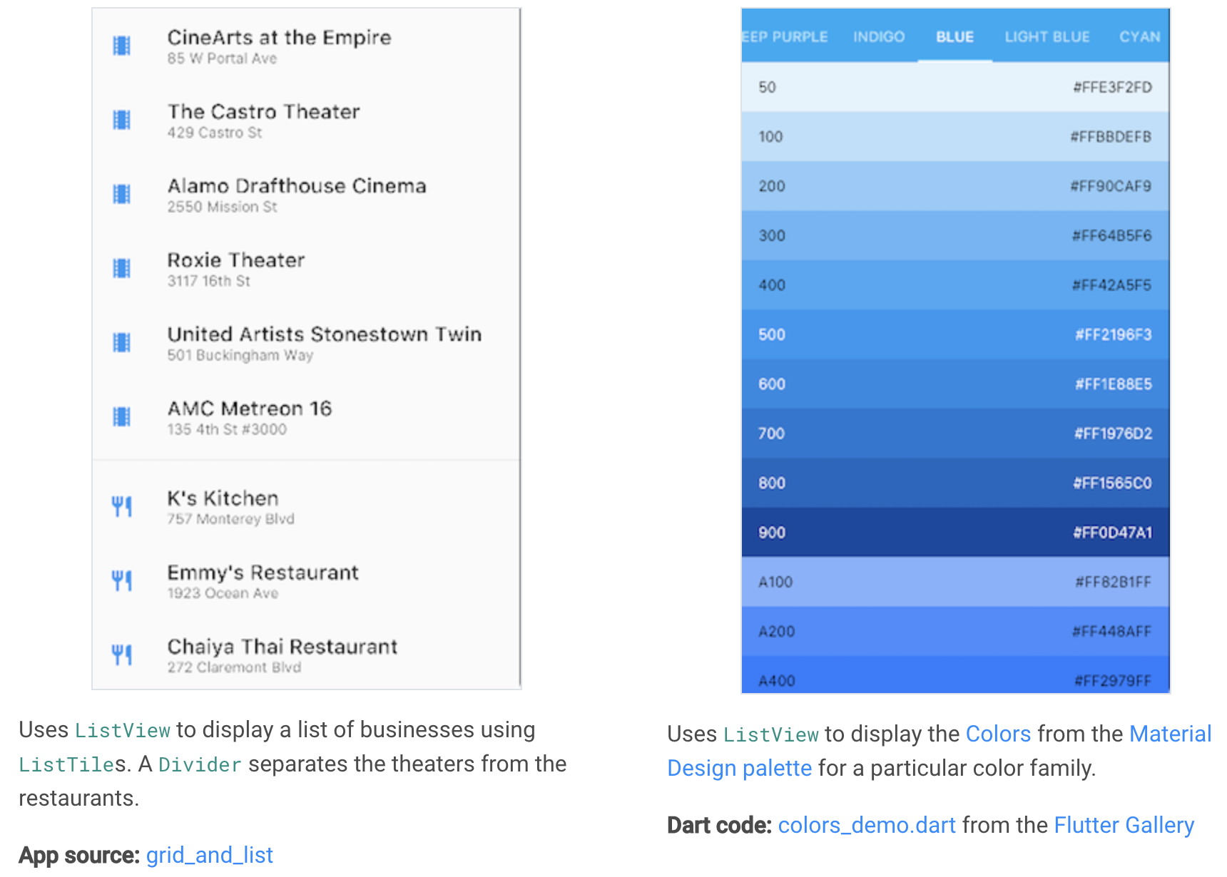
Examples (ListView)
App source: grid_and_list
Dart code: colors_demo.dart from the Flutter Gallery

Slide 58
Stack
Use for widgets that overlap another widget
The first widget in the list of children is the base widget; subsequent children are overlaid on top of that base widget
A Stack’s content can’t scroll
You can choose to clip children that exceed the render box

Slide 59
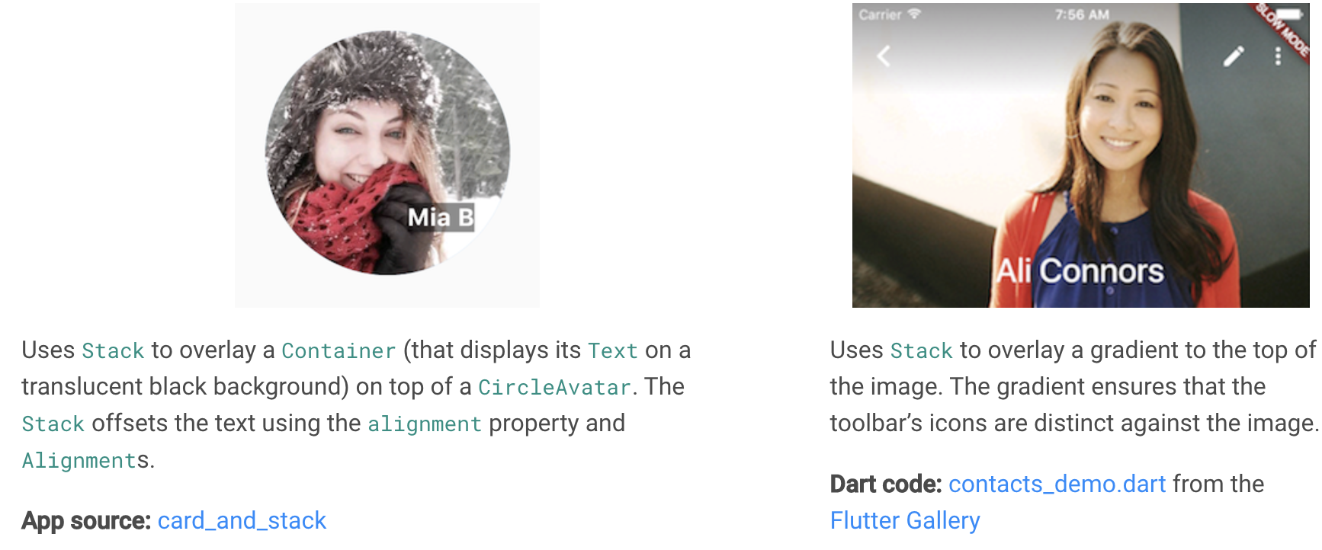
Examples (Stack)
App source: card_and_stack
Dart code: contacts_demo.dart from the Flutter Gallery

Slide 60
Card
Implements a Material card
Used for presenting related nuggets of information
Accepts a single child, but that child can be a Row, Column, or other widget that holds a list of children
Displayed with rounded corners and a drop shadow
A Card’s content can’t scroll
From the Material library

Slide 61
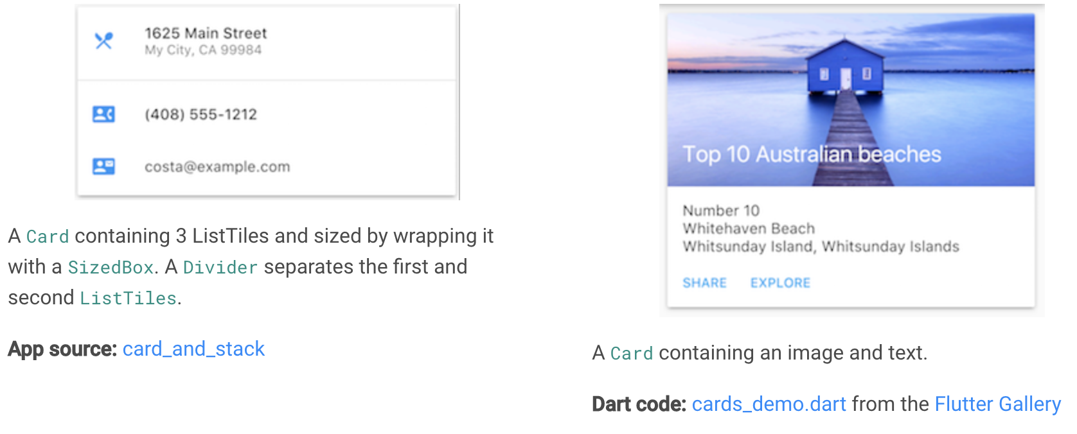
Examples (Card)
App source: card_and_stack
Dart code: cards_demo.dart from the Flutter Gallery

Slide 62
ListTile
A specialized row that contains up to 3 lines of text and optional icons
Less configurable than Row, but easier to use
From the Material library

Slide 63
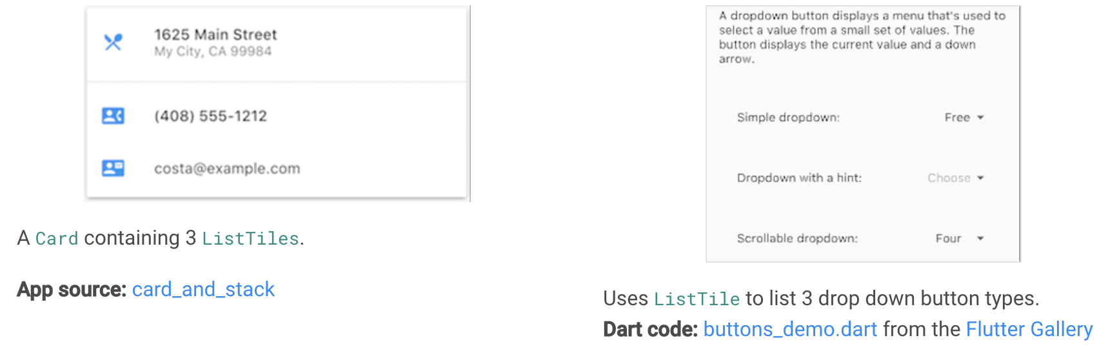
Examples (ListTile)
App source: card_and_stack
Dart code: buttons_demo.dart from the Flutter Gallery

Slide 64
Other resources
Layout tutorial: Learn how to build a layout.
Widget Overview: Describes many of the widgets available in Flutter.
HTML/CSS Analogs in Flutter: For those familiar with web programming, this page maps HTML/CSS functionality to Flutter features.
Flutter Gallery: Demo app showcasing many Material Design widgets and other Flutter features.
Flutter API documentation: Reference documentation for all of the Flutter libraries.
Dealing with Box Constraints in Flutter: Discusses how widgets are constrained by their render boxes.
Adding Assets and Images in Flutter: Explains how to add images and other assets to your app’s package.
Zero to One with Flutter: One person’s experience writing his first Flutter app.

Slide 65
Splash screen
Notes:
StatelessWidget is used for immutable elements that only rely on the object configuration information
StatefulWidget is used for elements that can dynamically change based on state-changes in the system
Everytime that state changes, setChange() is called by the object

Slide 66
Adding a splash screen
Flutter supports the display of a launch screen while your Android app initializes, and also supports the display of a splash screen while your Flutter experience initializes.

Slide 67
Android launch screen
Every Android app requires initialization time while the operating system sets up the app’s process.
Android provides the concept of a launch screen to display a Drawable while the app is initializing.

Slide 68
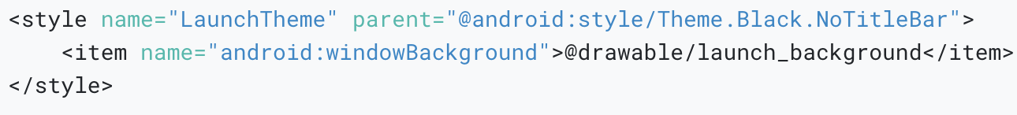
Define a launch theme
In styles.xml, define a theme whose windowBackground is set to the Drawable that should be displayed as the launch screen.

Slide 69
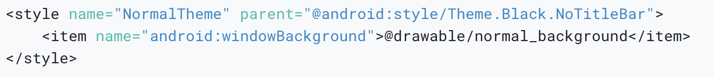
Define a normal theme
In styles.xml, define a normal theme to be applied to FlutterActivity after the launch screen is gone.
The normal theme background only shows for a very brief moment after the splash screen disappears, and during orientation change and Activity restoration.

Slide 70
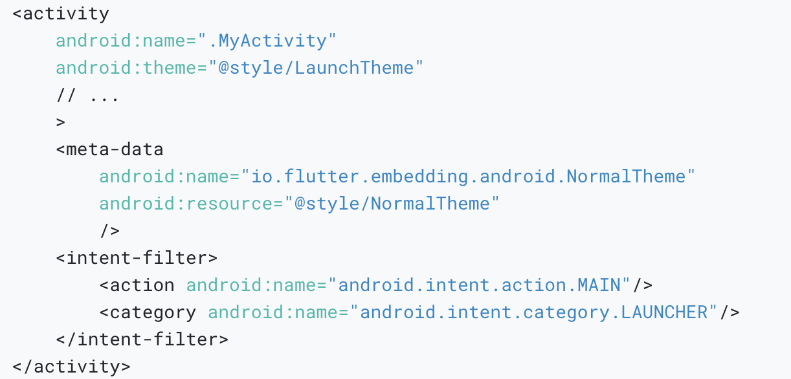
Setup FlutterActivity in AndroidManifest.xml
In AndroidManifest.xml, set the theme of FlutterActivity to the launch theme.

Slide 71
Flutter splash screen
Flutter supports two options for a splash screen.
The first option is to display a Drawable of your choice, which fades out after the initialization is complete.
The other option is to provide a custom SplashScreen, which is capable of displaying any Android View content that you want.

Slide 72
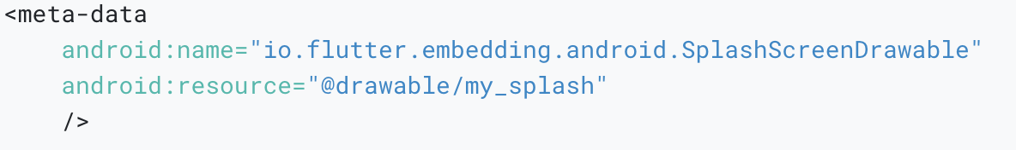
In a FlutterActivity
To display a Drawable as a Flutter splash screen in a FlutterActivity, add the following metadata to the associated FlutterActivity in AndroidManifest.xml.

Slide 73
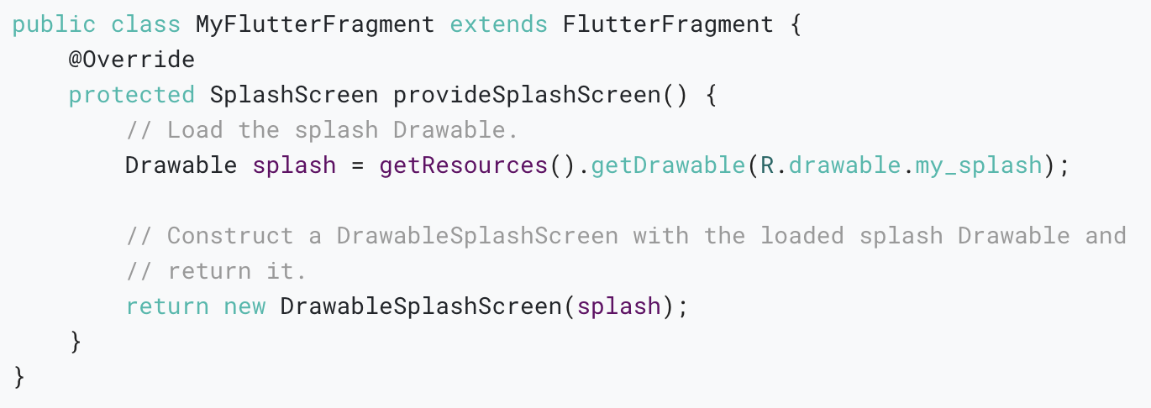
In a FlutterFragment
To display a Drawable as a Flutter splash screen in a FlutterFragment, make FlutterFragment a subclass and override provideSplashScreen().

Slide 74
Creating a custom SplashScreen
Splash screens are a great branding opportunity.
Because of that, many teams implement unique, highly customized splash experiences.
To facilitate this, Flutter allows you to display an arbitrary Android View as a splash screen, and even allows you to control how that View transitions to Flutter after Flutter renders its first frame.

Slide 75
Implement a custom splash View
First, define the custom View that should be displayed as the splash screen.
This View could display anything, from a simple solid color to an animation. An example isn’t provided because there are too many options.

Slide 76
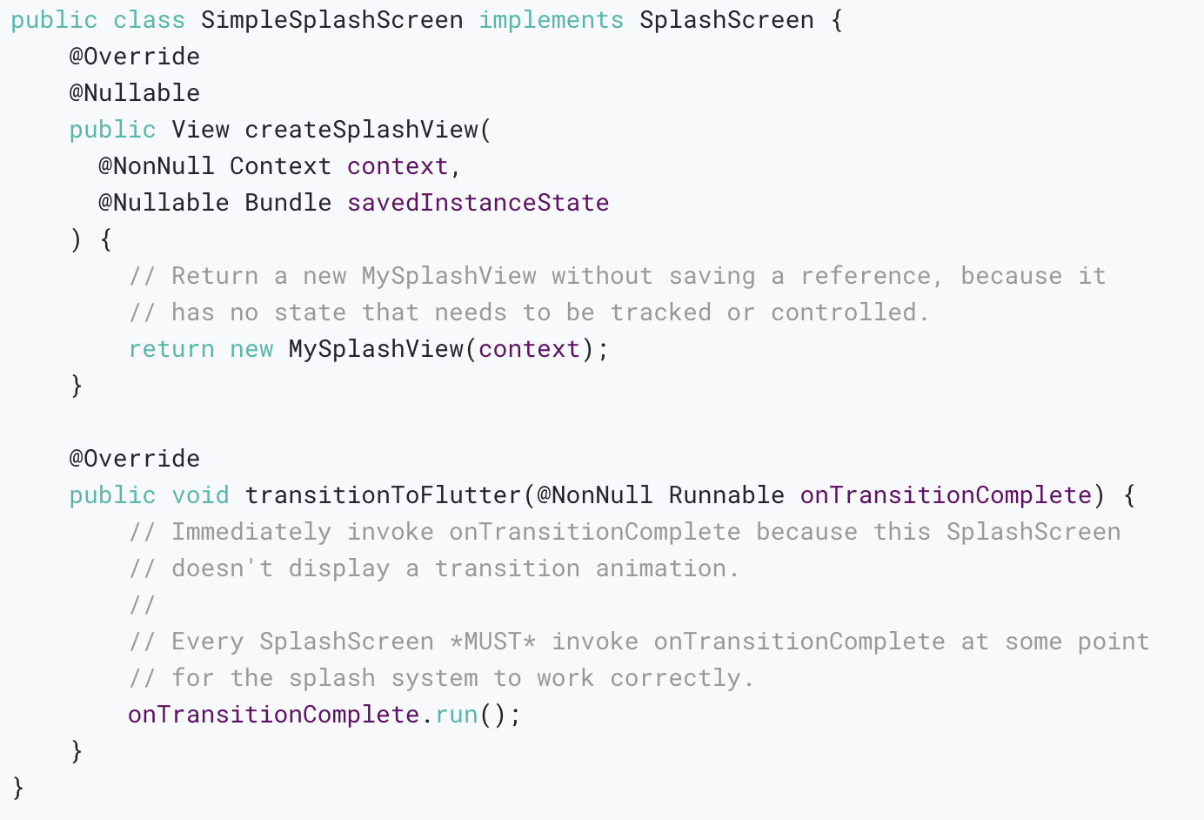
Implement the SplashScreen interface
First, the following is an example of a SplashScreen that has no visual state and no transition animation.

Slide 77
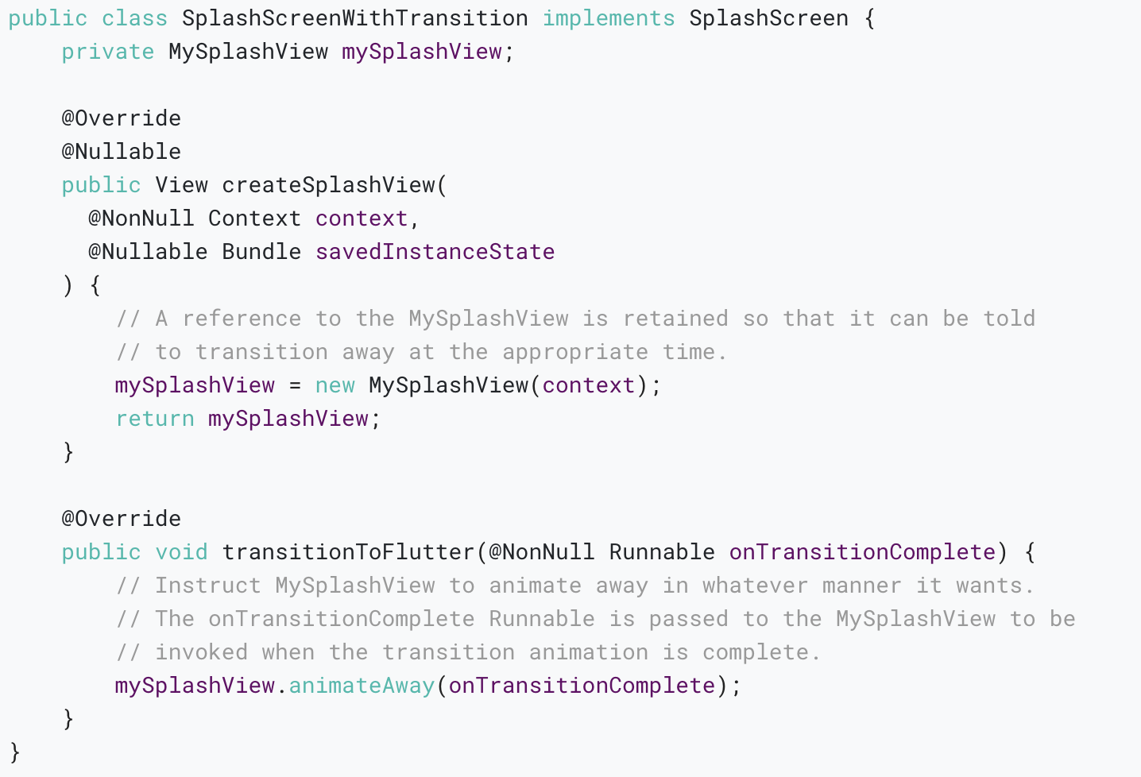
The second example.
The custom SplashScreen keeps a reference to its custom View and instructs the custom View to transition away, passing the onTransitionComplete callback to the custom View to invoke.

Slide 78
Adding interactivity
Notes:
StatelessWidget is used for immutable elements that only rely on the object configuration information
StatefulWidget is used for elements that can dynamically change based on state-changes in the system
Everytime that state changes, setChange() is called by the object

Slide 79
What you’ll learn
How to respond to taps.
How to create a custom widget.
The difference between stateless and stateful widgets.

Slide 80
Layout tutorial showed you how to create the layout for the following screenshot.
In this tutorial, you’ll add interactivity to an app that contains only non-interactive widgets.
Specifically, you’ll modify an icon to make it tappable by creating a custom stateful widget that manages two stateless widgets.

Slide 81
Stateful and stateless widgets
A widget is either stateful or stateless.
A stateless widget never changes. Icon, IconButton, and Text are examples of stateless widgets. Stateless widgets subclass StatelessWidget.
A stateful widget is dynamic: for example, it can change its appearance in response to events triggered by user interactions or when it receives data. Checkbox, Radio, Slider, InkWell, Form, and TextField are examples of stateful widgets. Stateful widgets subclass StatefulWidget.
A widget’s state is stored in a State object, separating the widget’s state from its appearance.

Slide 82
Creating a stateful widget
This section shows you how to build a stateful widget, called FavoriteWidget, for the lakes app.
After setting up, your first step is choosing how state is managed for FavoriteWidget.

Slide 83
Step 0: Get ready
Make sure you’ve set up your environment.
Create a basic “Hello World” Flutter app.
Replace the lib/main.dart file with main.dart.
Replace the pubspec.yaml file with pubspec.yaml.
Create an images directory in your project, and add lake.jpg.

Slide 84
Step 1: Decide which object manages the widget’s state
A widget’s state can be managed in several ways, but in our example the widget itself, FavoriteWidget, will manage its own state.
In this example, toggling the star is an isolated action that doesn’t affect the parent widget or the rest of the UI, so the widget can handle its state internally.

Slide 85
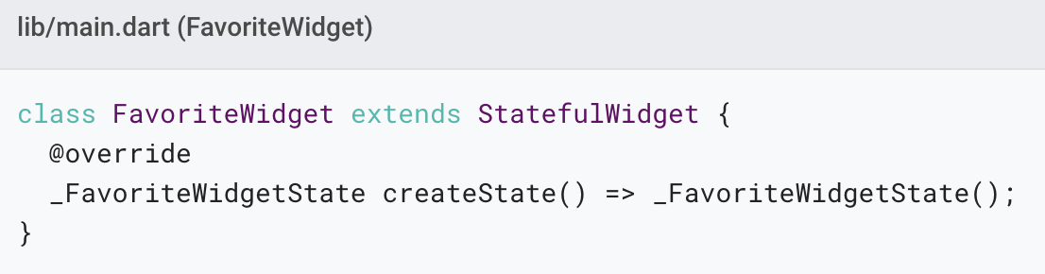
Step 2: Subclass StatefulWidget
The FavoriteWidget class manages its own state, so it overrides createState() to create a State object.

Slide 86
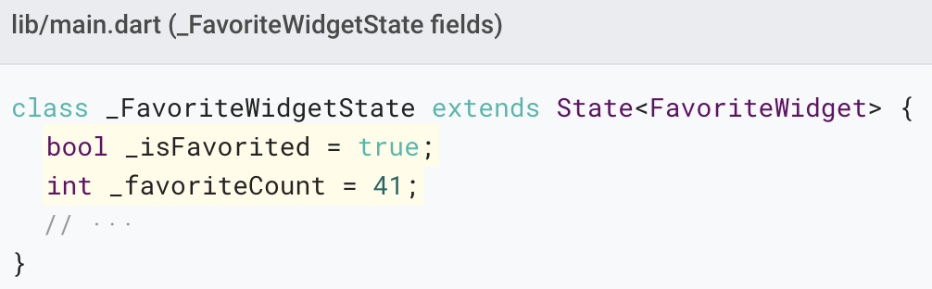
Step 3: Subclass State
The _FavoriteWidgetState class stores the mutable data that can change over the lifetime of the widget.

Slide 87
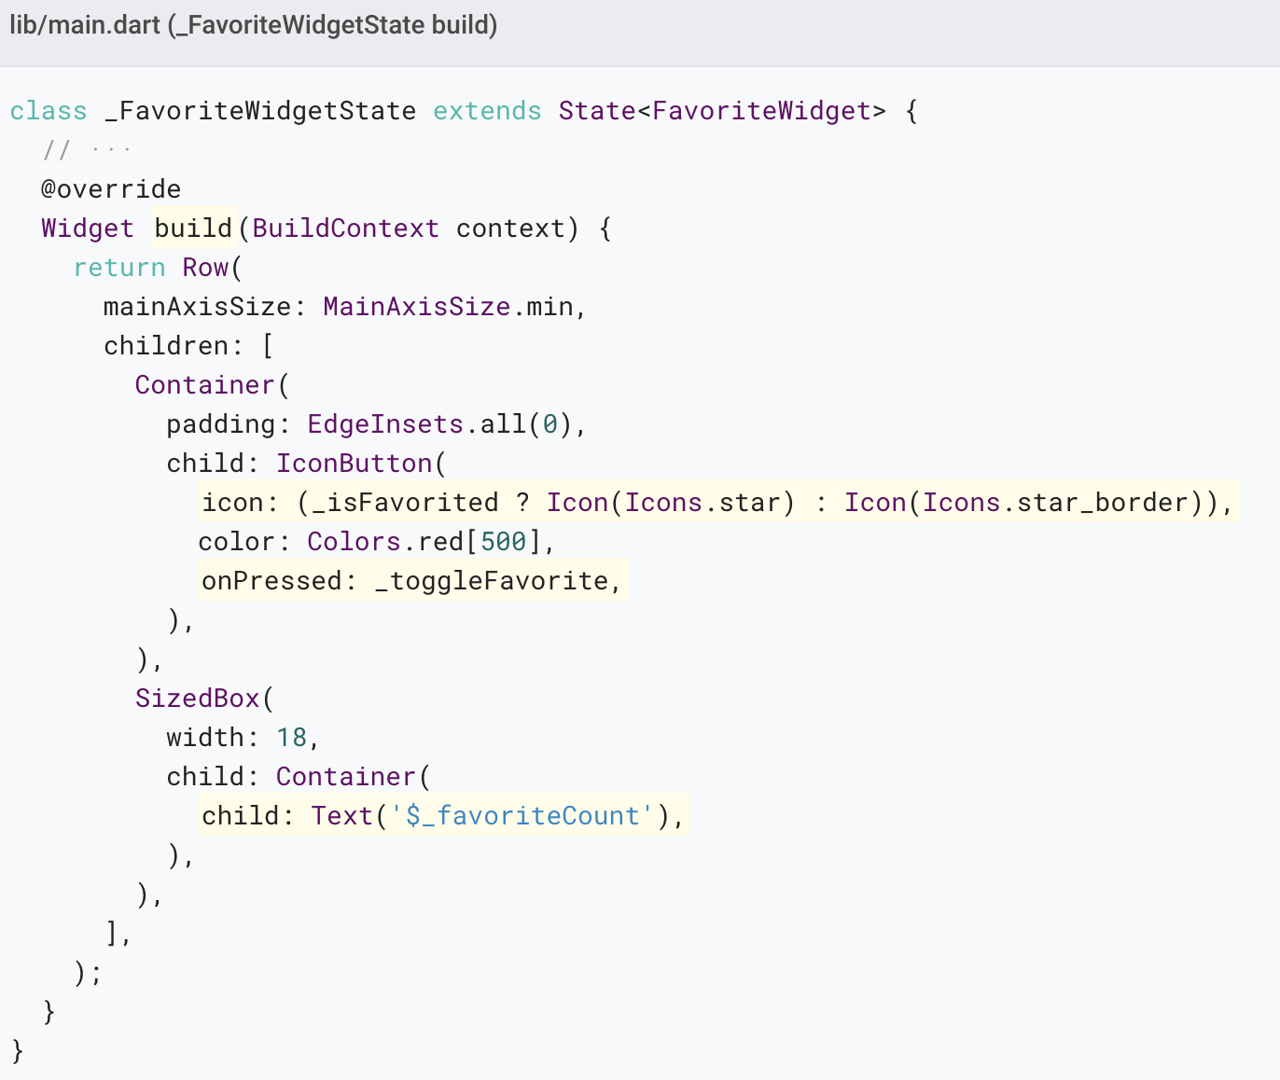
The class also defines a build() method, which creates a row containing a red IconButton, and Text.

Slide 88
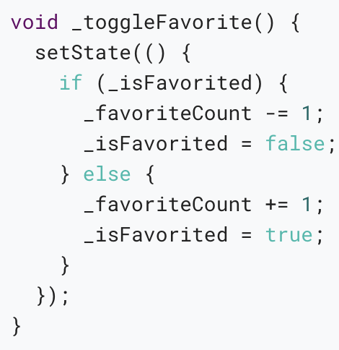
The _toggleFavorite() method, which is called when the IconButton is pressed, calls setState().

Slide 89
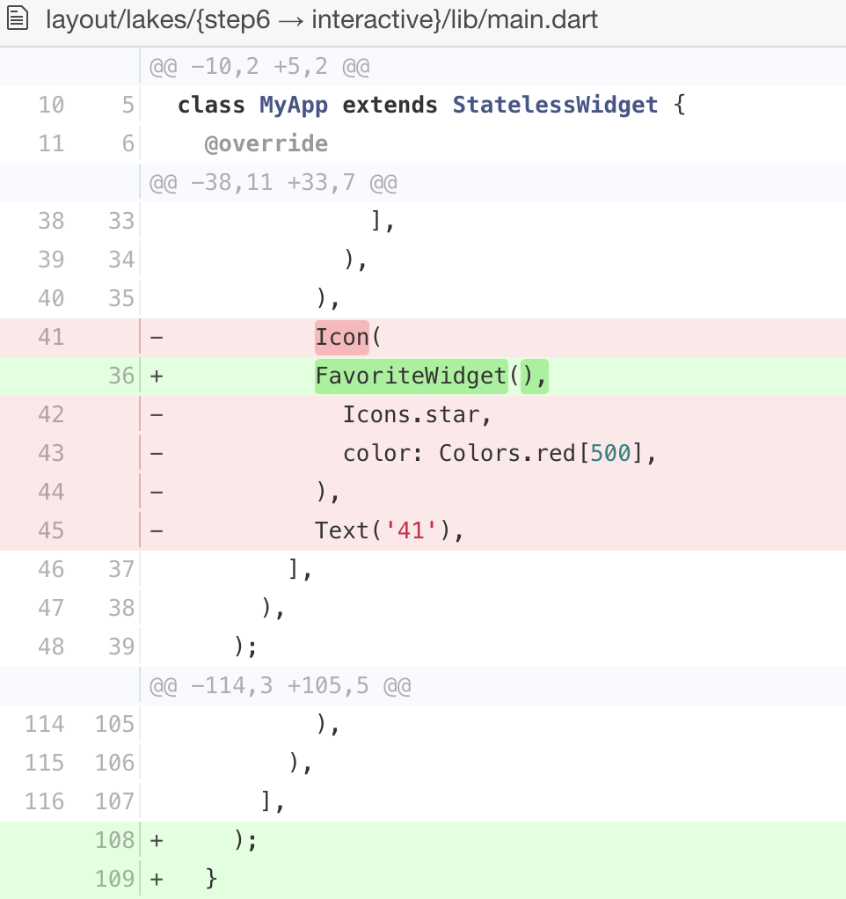
Step 4: Plug the stateful widget into the widget tree
Add your custom stateful widget to the widget tree in the app’s build() method.

Slide 90
Problems?
If you can’t get your code to run, look in your IDE for possible errors. Debugging Flutter Apps might help.
If you still can’t find the problem, check your code against the interactive lakes example on GitHub.
lib/main.dart
pubspec.yaml
lakes.jpg

Slide 91
Managing state
Here are the most common ways to manage state:
The widget manages its own state
The parent manages the widget’s state
A mix-and-match approach

Slide 92
We’ll give examples of the different ways of managing state by creating three simple examples: TapboxA, TapboxB, and TapboxC.
The examples all work similarly—each creates a container that, when tapped, toggles between a green or grey box.

Slide 93
Sometimes it makes the most sense for the widget to manage its state internally.
For example, ListView automatically scrolls when its content exceeds the render box.
Most developers using ListView don’t want to manage ListView’s scrolling behavior, so ListView itself manages its scroll offset.

Slide 94
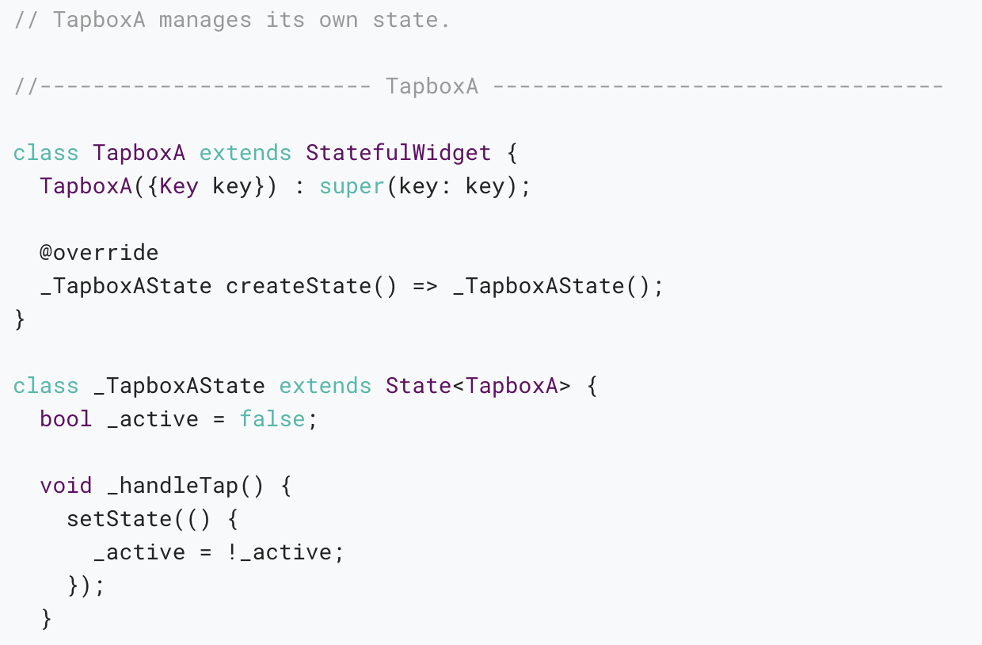
The widget manages its own state

Slide 95
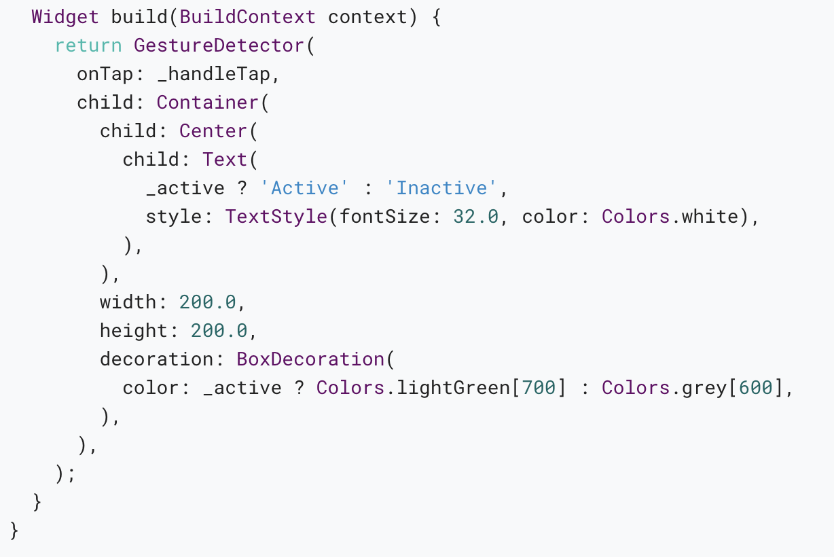

Slide 96
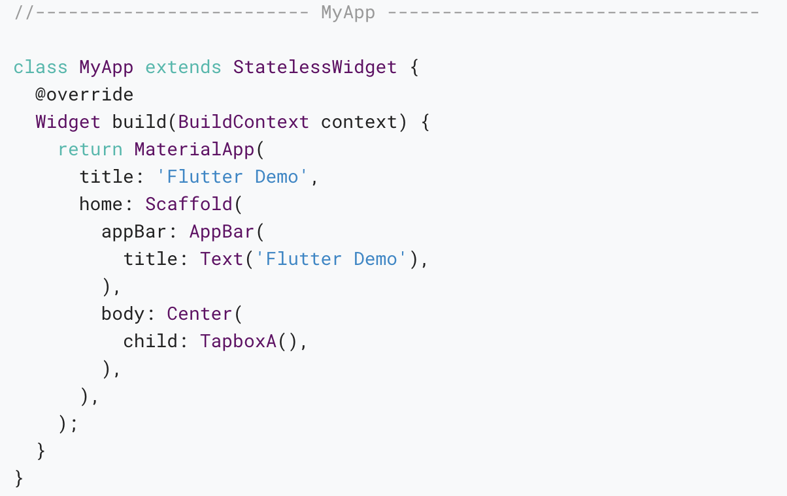

Slide 97
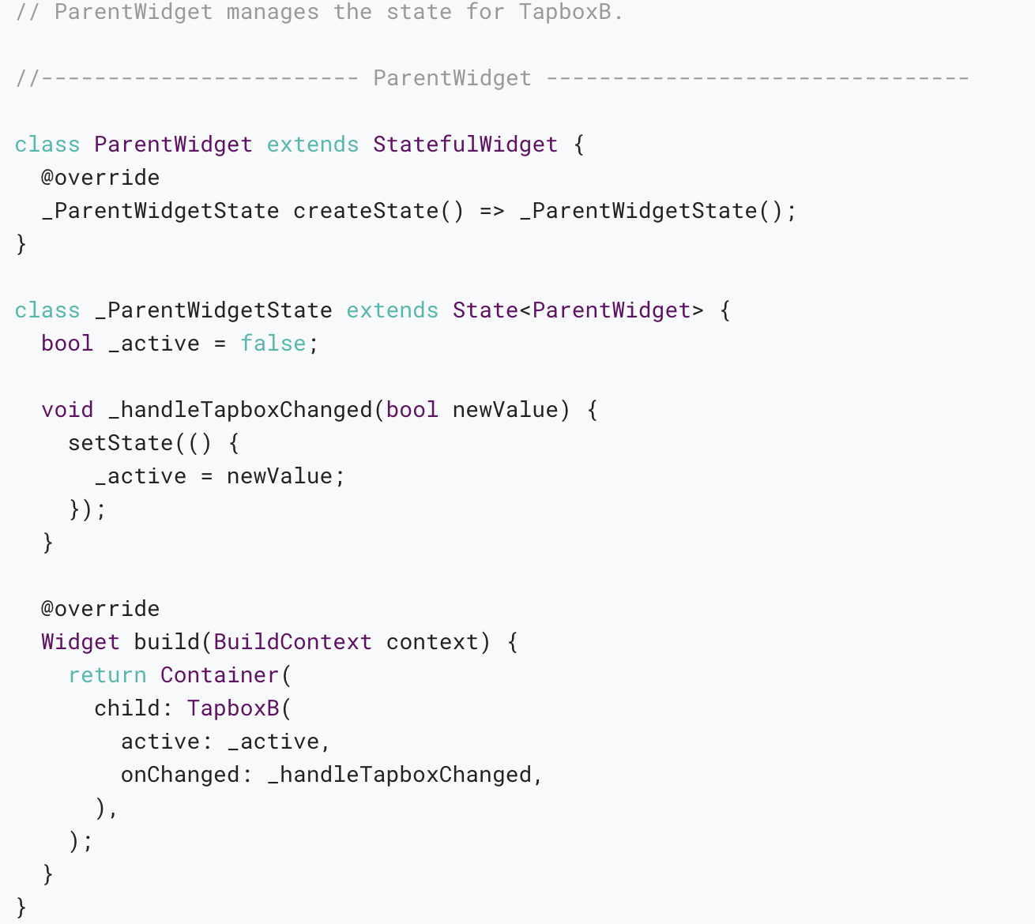
The parent widget manages the widget’s state

Slide 98


Slide 99

A mix-and-match approach

Slide 100


Slide 101


Slide 102
Other interactive widgets
Flutter offers a variety of buttons and similar interactive widgets. Most of these widgets implement the Material Design guidelines, which define a set of components with an opinionated UI.
If you prefer, you can use GestureDetector to build interactivity into any custom widget. You can find examples of GestureDetector in Managing state, and in the Flutter Gallery.

Slide 103
Standard widgets
Form
FormField

Slide 104
Material Components
Checkbox
DropdownButton
FlatButton
FloatingActionButton
IconButton
Radio
RaisedButton
Slider
Switch
TextField

Slide 105
Resources
Gestures, a section in Introduction to widgets How to create a button and make it respond to input.
Gestures in Flutter A description of Flutter’s gesture mechanism.
Flutter API documentation Reference documentation for all of the Flutter libraries.
Flutter Gallery Demo app showcasing many Material Components and other Flutter features.
Flutter’s Layered Design (video) This video includes information about state and stateless widgets. Presented by Google engineer, Ian Hickson.

Slide 106
Adding assets and images
Notes:
StatelessWidget is used for immutable elements that only rely on the object configuration information
StatefulWidget is used for elements that can dynamically change based on state-changes in the system
Everytime that state changes, setChange() is called by the object

Slide 107

Specifying assets
Flutter uses the pubspec.yaml file, located at the root of your project, to identify assets required by an app.

Slide 108
Asset bundling
The assets subsection of the flutter section specifies files that should be included with the app.
Each asset is identified by an explicit path (relative to the pubspec.yaml file) where the asset file is located.
The order in which the assets are declared does not matter.
The actual directory used (assets in this case) does not matter.

Slide 109
Asset variants
The build process supports the notion of asset variants: different versions of an asset that might be displayed in different contexts.
When an asset’s path is specified in the assets section of pubspec.yaml, the build process looks for any files with the same name in adjacent subdirectories.
Such files are then included in the asset bundle along with the specified asset.

Slide 110
Loading assets
Your app can access its assets through an AssetBundle object.
The two main methods on an asset bundle allow you to load a string/text asset (loadString()) or an image/binary asset (load()) out of the bundle, given a logical key.
The logical key maps to the path to the asset specified in the pubspec.yaml file at build time.

Slide 111

Loading text assets
Each Flutter app has a rootBundle object for easy access to the main asset bundle. It is possible to load assets directly using the rootBundle global static from package:flutter/services.dart.

Slide 112

Loading images
Flutter can load resolution-appropriate images for the current device pixel ratio.

Slide 113


Slide 114

Asset images in package dependencies
To load an image from a package dependency, the package argument must be provided to AssetImage.

Slide 115


Slide 116

Sharing assets with the underlying platform
Loading Flutter assets in Android
On Android the assets are available via the AssetManager API.

Slide 117

Loading Flutter assets in iOS
On iOS the assets are available via the mainBundle.

Slide 118
Loading iOS images in Flutter
When implementing Flutter as Add-to-app, you might have images hosted in iOS which you want to use in Flutter.
For accomplishing that there is a plugin available on pub.dev called ios_platform_images.

Slide 119
Platform assets
There are other occasions to work with assets in the platform projects directly.
Below are two common cases where assets are used before the Flutter framework is loaded and running.

Slide 120
Updating the app icon
Updating a Flutter application’s launch icon works the same way as updating launch icons in native Android or iOS applications.

Slide 121
Android
In your Flutter project’s root directory, navigate to .../android/app/src/main/res.

Slide 122
iOS
In your Flutter project’s root directory, navigate to .../ios/Runner.
The Assets.xcassets/AppIcon.appiconset directory already contains placeholder images.

Slide 123
Updating the launch screen
Flutter also uses native platform mechanisms to draw transitional launch screens to your Flutter app while the Flutter framework loads.
This launch screen persists until Flutter renders the first frame of your application.

Slide 124
Thank you!
Wenxuan Shi
College of Software, Nankai University
Email: shiwx@nankai.edu.cn
Wechat: 13920561100

